Slide 1


IMDb Age Disparity Data Analysis & Observations 2001-2021
By Glo McCollough
April 2022

Slide 2

Introduction:
Have you ever searched IMDb’s vast online database to look up information on actors, actresses, movies, and TV shows?
Me too!
I personally find myself in IMDb at least once a week trying to either win a bragging rights bet with my partner on where I’ve seen a particular actor/actress before or looking up a movie title for various trivia facts.
After thoughtfully using this data-tools for many, many years, I have always had a burning question and wanted to take this opportunity to take a stab at answering it.

Slide 3
Table of Contents
The Data Analysis Presentation:
What is IMDb?
How IMDb gets its information?
What was the original data question?
Yes, the original question evolved, a lot!
The final data question used for this exercise is....
Ready for some graphs?
Age Disparity | All Genres
Age Disparity | Tag: Action
Age Disparity | Tag: Comedy
Age Disparity | Tag: Drama
Age Disparity | Tag: Fantasy
Age Disparity | Tag: Romance
Age Disparity | Tag: Sci-Fi
But what does this all mean?
Ta-Da…..
Another way to look at this data…
The conclusion of this analysis
Documentation | Code | Details:
This is the really geeky stuff
How this Data Analysis began
What it took to complete this document
Understanding the data
SQL created for the analysis
R script created for the analysis
How to ask for help

Slide 4
What is IMDb?
IMDb which stands for the “Internet Movie Database” is located at the URL https://www.imdb.com/.
Per Wikipedia, “IMDb” is an online database of information related to films, television series, home videos, video games, and streaming content online – including cast, production crew and personal biographies, plot summaries, trivia, ratings, and fan and critical reviews. IMDb began as a fan-operated movie database on the Usenet group "rec.arts.movies" in 1990, and moved to the web in 1993. It is now owned and operated by IMDb.com, Inc., a subsidiary of Amazon.
As of February 2022, the database contained some 8.7 million titles (including television episodes) and 11.4 million person records. Additionally, the site had 83 million registered users.

Slide 5
How IMDb gets its information?
Per IMDb’s general information article, “While we actively gather information from and verify items with studios and filmmakers, the bulk of our information is submitted by people in the industry and visitors like you!
In addition to using as many sources as we can, our data goes through consistency checks to ensure it's as accurate and reliable as possible. However, there's absolutely no substitute for an international team of entertainment fans with an encyclopedic knowledge of trivia and a large assortment of reference works (and we include in this group many of our loyal contributors).
Our sources of information include, but are not limited to on-screen credits, press kits, official bios, autobiographies, and interviews.”
You can read the full article here: https://tinyurl.com/4ksrcmp6

Slide 6
What was the original data question?
The entire point of looking over, sorting, filtering, and visualizing data is to answer a question. Sometimes that is a single question, sometimes there are layers to it.
When I began this data journey, I had a single basic question in mind:
“Is there, and to what extent, a significant age gap between those who are listed as Actors vs Actresses within the IMDb database?”
It’s funny what one learns about the data that they do, and don’t have, as well as the shear volume of data to sift through. Trust me when I tell you, the IMDb database and its specific tables are huge, and I mean huge! More on that later.

Slide 7
Yes, the original question evolved.
I quickly learned at the beginning of my analysis that the raw IMDb data contained a lot more information than I had imagined. My original question needed to be expanded and this data needed to be sifted …….
The raw data included information on movies, TV shows, music videos, shorts, video games and so on. It also conveniently listed if a particular title was labeled “adult.” Interesting fact, the oldest film listed on IMDb is “Roundhay Garden Scene” from 1888.
I chose to refocus the question to filter only on movies specifically made for the United States and in English between the years 2001-2021 that were not considered “adult” content as defined by IMDb.
There could be any number of actor/actresses on a cast and crew list.
I narrowed down the selection to choose only the top three “actors” and/or “actresses.’
Not every title has equal actor/actress within the first 3 listed leads.
I knew that I could focus on the mean/average per a particular timeframe and as long as I specifically filtered for actor and/or actress, the overall data answer should be adequate for the purposes of this exercise.
There were a lot of movie titles between 2001-2021. IMDb breaks down it’s movies by using specific genre tags, in multiples, per title.
I chose to focus on my personal favorites which include Action, Comedy, Fantasy, Drama, Romance, and Sci-Fi. This way I could see if a particular genre, as defined by IMDb contained a wider or smaller age gap between actors and actresses. If you are curious about IMDb’s definitions of their genre tags, check out this link: https://tinyurl.com/msp6mupc

Slide 8
So, what was the final data question used for this exercise?
It actually turned into 3 questions, all relative to the same goal:
Is there a significant age gap between Actors and/or Actresses listed within the top 3 cast and crew attached to US/EN movies between 2001 and 2021?
What about by decade within that time-frame?
Also, would specific genres make a difference such as Action, Comedy, Fantasy, Drama, Romance, and Sci-Fi categories?

Slide 9
Ready for some graphs? Me too!

Slide 10
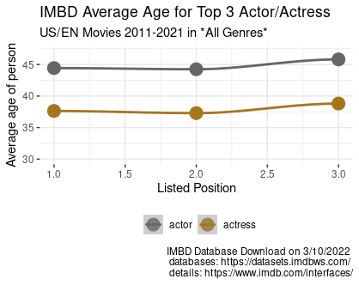
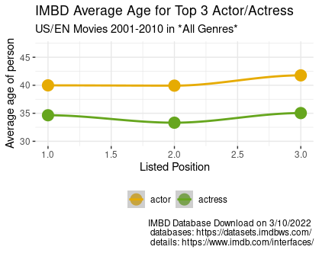
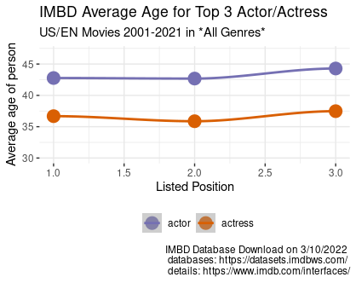
Age Disparity | All Genres
Years | Position Avg Age Diff | Position Avg Age Diff | Position Avg Age Diff
2001-2021 | 1 actor 42.8 1 actress 36.7 -6.8 | 2 actor 42.7 2 actress 35.9 -6.8 | 3 actor 44.3 3 actress 37.5 -6.8
2001-2010 | 1 actor 40.0 1 actress 34.6 -5.4 | 2 actor 39.9 2 actress 33.3 -6.6 | 3 actor 41.8 3 actress 35.0 -6.8
2011-2021 | 1 actor 44.4 1 actress 37.6 -6.8 | 2 actor 44.2 2 actress 37.3 -6.9 | 3 actor 45.8 3 actress 38.8 -7.0
*mean/averages will look off because the number of titles per decade changes | All Genres 2001-2010 = 20,411 2011-2021 = 40,328

Slide 11
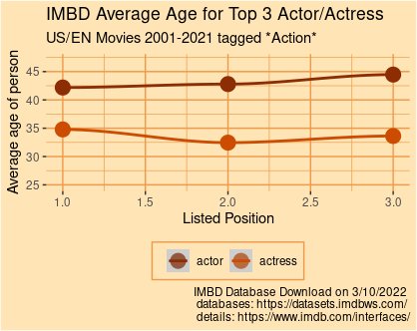
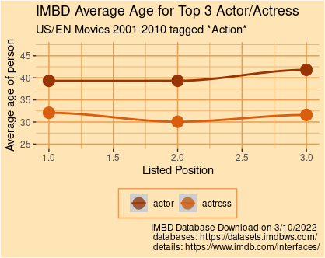
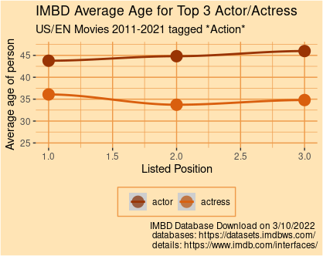
Age Disparity | Tag: Action
Years | Position Avg Age Diff | Position Avg Age Diff | Position Avg Age Diff
2001-2021 | 1 actor 42.2 1 actress 34.8 -7.4 | 2 actor 42.8 2 actress 32.5 -10.3 | 3 actor 44.5 3 actress 33.6 -10.9
2001-2010 | 1 actor 39.3 1 actress 32.1 -7.2 | 2 actor 39.3 2 actress 30.1 -9.2 | 3 actor 41.8 3 actress 31.6 -10.2
2011-2021 | 1 actor 43.8 1 actress 36.1 -7.7 | 2 actor 44.8 2 actress 33.7 -11.1 | 3 actor 46.0 3 actress 34.8 -11.2
*mean/averages will look off because the number of titles per decade changes | Tag: Action 2001-2010 = 2,631 2011-2021 = 5,257

Slide 12
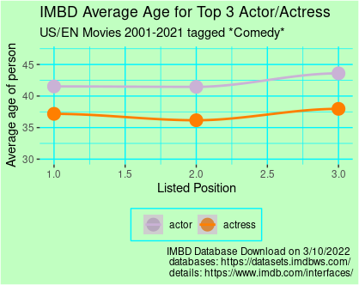
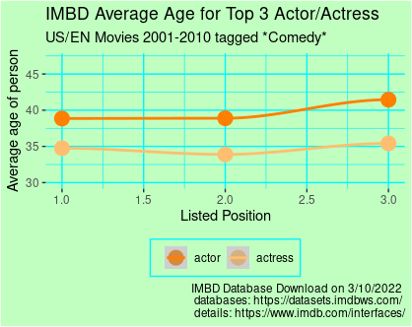
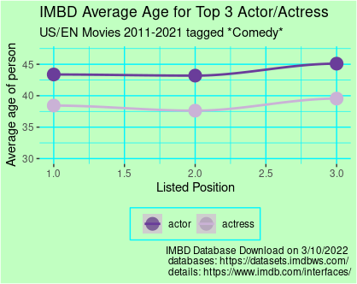
Age Disparity | Tag: Comedy
Years | Position Avg Age Diff | Position Avg Age Diff | Position Avg Age Diff
2001-2021 | 1 actor 41.5 1 actress 37.2 -4.3 | 2 actor 41.5 2 actress 36.2 -5.3 | 3 actor 43.6 3 actress 38.0 -5.6
2001-2010 | 1 actor 38.9 1 actress 34.8 -4.1 | 2 actor 38.9 2 actress 33.9 -5 | 3 actor 41.5 3 actress 35.4 -6.1
2011-2021 | 1 actor 43.4 1 actress 38.4 -5 | 2 actor 43.2 2 actress 37.6 -5.6 | 3 actor 45.1 3 actress 39.5 -5.6
*mean/averages will look off because the number of titles per decade changes | Tag: Comedy 2001-2010 = 6,539 2011-2021 = 11,165

Slide 13
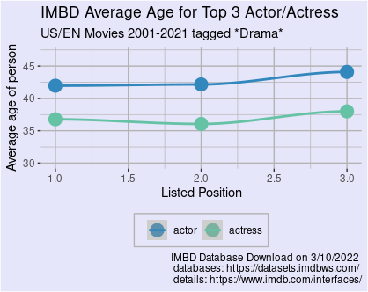
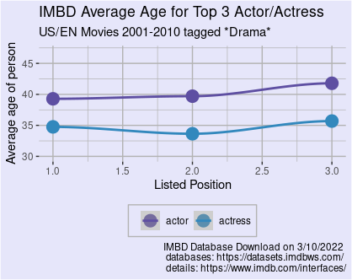
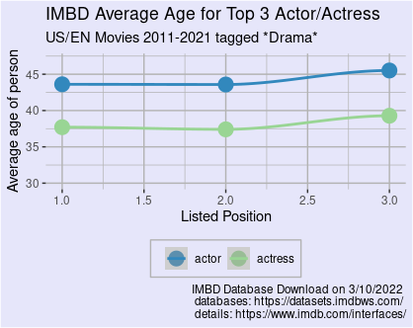
Age Disparity | Tag: Drama
Years | Position Avg Age Diff | Position Avg Age Diff | Position Avg Age Diff
2001-2021 | 1 actor 42.8 1 actress 36.8 -6 | 2 actor 42.2 2 actress 36.0 -6.2 | 3 actor 44.1 3 actress 38.0 -6.1
2001-2010 | 1 actor 39.3 1 actress 34.8 -4.5 | 2 actor 39.7 2 actress 33.6 -6.1 | 3 actor 41.8 3 actress 35.7 -6.1
2011-2021 | 1 actor 43.6 1 actress 37.7 -5.9 | 2 actor 43.6 2 actress 37.4 -6.2 | 3 actor 45.5 3 actress 39.3 -6.2
*mean/averages will look off because the number of titles per decade changes | Tag: Drama 2001-2010 = 10,618 2011-2021 = 20,801

Slide 14
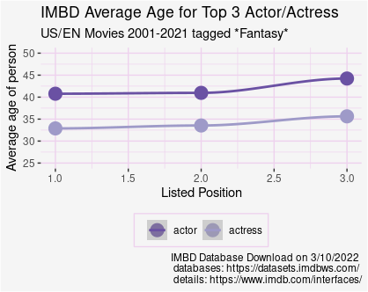
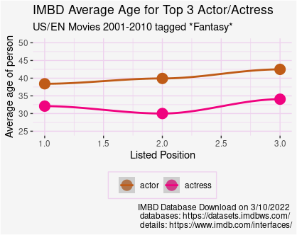
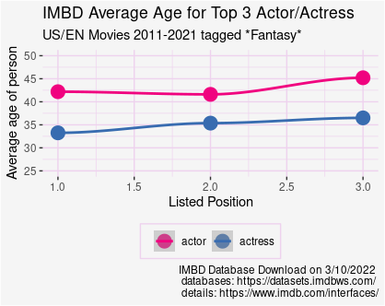
Age Disparity | Tag: Fantasy
Years | Position Avg Age Diff | Position Avg Age Diff | Position Avg Age Diff
2001-2021 | 1 actor 40.8 1 actress 32.9 -7.9 | 2 actor 41.0 2 actress 33.5 -7.5 | 3 actor 44.2 3 actress 35.6 -8.6
2001-2010 | 1 actor 38.4 1 actress 32.1 -6.3 | 2 actor 39.9 2 actress 30.0 -9.9 | 3 actor 42.5 3 actress 34.1 -8.4
2011-2021 | 1 actor 42.2 1 actress 33.3 -8.9 | 2 actor 41.0 2 actress 35.4 -5.6 | 3 actor 45.2 3 actress 36.5 -8.7
*mean/averages will look off because the number of titles per decade changes | Tag: Fantasy 2001-2010 = 839 2011-2021 = 1,749

Slide 15
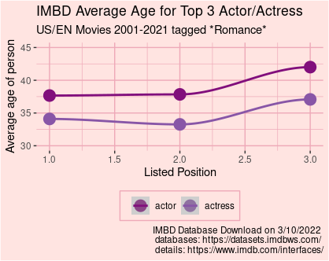
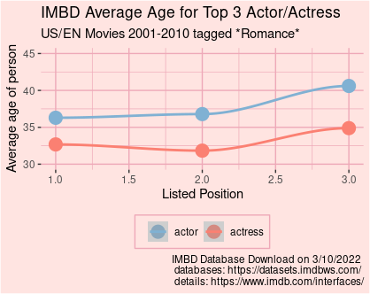
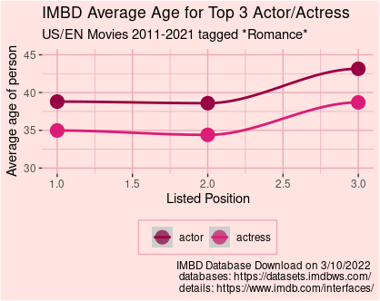
Age Disparity | Tag: Romance
Years | Position Avg Age Diff | Position Avg Age Diff | Position Avg Age Diff
2001-2021 | 1 actor 37.7 1 actress 34.1 -3.6 | 2 actor 37.8 2 actress 33.3 -4.5 | 3 actor 42.0 3 actress 37.1 -4.9
2001-2010 | 1 actor 36.3 1 actress 32.7 -3.6 | 2 actor 36.8 2 actress 31.8 -5 | 3 actor 40.6 3 actress 34.9 -5.7
2011-2021 | 1 actor 38.8 1 actress 35.0 -3.8 | 2 actor 38.6 2 actress 34.4 -4.2 | 3 actor 43.1 3 actress 38.7 -4.1
*mean/averages will look off because the number of titles per decade changes | Tag: Romance 2001-2010 = 2,983 2011-2021 = 4,530

Slide 16
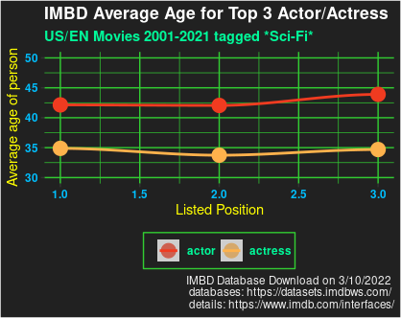
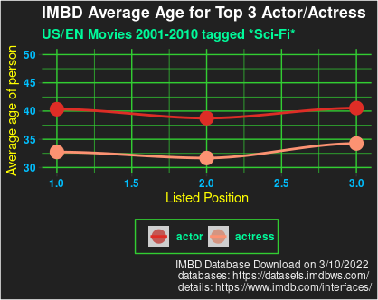
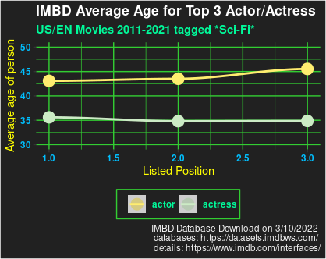
Age Disparity | Tag: Sci-Fi
Years | Position Avg Age Diff | Position Avg Age Diff | Position Avg Age Diff
2001-2021 | 1 actor 42.1 1 actress 34.9 -7.2 | 2 actor 42.1 2 actress 33.7 -8.4 | 3 actor 43.9 3 actress 34.7 -9.2
2001-2010 | 1 actor 40.3 1 actress 32.7 -7.6 | 2 actor 38.8 2 actress 31.7 -7.1 | 3 actor 40.5 3 actress 34.3 -6.2
2011-2021 | 1 actor 43.1 1 actress 35.6 -7.5 | 2 actor 43.5 2 actress 34.8 -8.7 | 3 actor 45.5 3 actress 34.9 -10.6
*mean/averages will look off because the number of titles per decade changes | Tag: Sci-Fi 2001-2010 = 714 2011-2021 = 1,716

Slide 17
But what does this all mean?
Is there a significant age gap between Actors and/or Actresses listed within the top 3 cast and crew attached to US/EN movies between 2001 and 2021?
Yes, absolutely. Though your definition of “a significant age gap” may differ from my own.
What about by decade within that time-frame?
Interestingly, the average differences didn’t change drastically from 2001-2010 to 2011-2021 however the average age for both actors and actresses moved slightly higher, not lower overall.
Also, would specific genres make a difference such as Action, Comedy, Fantasy, Drama, Romance, and Sci-Fi categories?
To keep the outcome of this analysis relative to when it completed, April 2022, I have supplied the age disparity details by genre tags on the next slide that pertain only to the last decade, 2011-2021

Slide 18
Ta-Da…..
Years | Position Avg Age Diff | Position Avg Age Diff | Position Avg Age Diff*#
**All Genres 2011-2021 | 1 actor 44.4 1 actress 37.6 -6.8 | 2 actor 44.2 2 actress 37.3 -6.9 | 3 actor 45.8 3 actress 38.8 -7.0
**All Genres includes tags outside of the 6 hand-picked for this analysis.
1
2
Years | Position Avg Age Diff | Position Avg Age Diff | Position Avg Age Diff*#
Action 2011-2021 | 1 actor 43.8 1 actress 36.1 -7.7 | 2 actor 44.8 2 actress 33.7 -11.1 | 3 actor 46.0 3 actress 34.8 -11.2
Comedy 2011-2021 | 1 actor 43.4 1 actress 38.4 -5 | 2 actor 43.2 2 actress 37.6 -5.6 | 3 actor 45.1 3 actress 39.5 -5.6
Drama 2011-2021 | 1 actor 43.6 1 actress 37.7 -5.9 | 2 actor 43.6 2 actress 37.4 -6.2 | 3 actor 45.5 3 actress 39.3 -6.2
Fantasy 2011-2021 | 1 actor 42.2 1 actress 33.3 -8.9 | 2 actor 41.0 2 actress 35.4 -5.6 | 3 actor 45.2 3 actress 36.5 -8.7
Romance 2011-2021 | 1 actor 38.8 1 actress 35.0 -3.8 | 2 actor 38.6 2 actress 34.4 -4.2 | 3 actor 43.1 3 actress 38.7 -4.1
Sci-Fi 2011-2021 | 1 actor 43.1 1 actress 35.6 -7.5 | 2 actor 43.5 2 actress 34.8 -8.7 | 3 actor 45.5 3 actress 34.9 -10.6
 | Position 1 Actresses are on average -6.5 years younger than their Actor counterparts | Position 2 Actresses are on average -6.9 years younger than their Actor counterparts | Position 3 Actresses are on average -7.7 years younger than their Actor counterparts

Slide 19
Another way to look at this data…
Let’s say you have an “Actor” in lead position one, and an “Actress” in lead position two.
The age disparity is still prevalent!
Based on this data, the averages never get closer than an almost 4-year age gap.
An important last note, the Romance category is the exception to the rule within the first 2 positions
Years | Position Avg Age Diff | Position Avg Age Diff | Position Avg Age Diff*#
**All Genres 2011-2021 | 1 actor 44.4 1 actress 37.6 -6.8 | 2 actor 44.2 2 actress 37.3 -6.9 | 3 actor 45.8 3 actress 38.8 -7.0
Action 2011-2021 | 1 actor 43.8 1 actress 36.1 -7.7 | 2 actor 44.8 2 actress 33.7 -11.1 | 3 actor 46.0 3 actress 34.8 -11.2
Comedy 2011-2021 | 1 actor 43.4 1 actress 38.4 -5 | 2 actor 43.2 2 actress 37.6 -5.6 | 3 actor 45.1 3 actress 39.5 -5.6
Drama 2011-2021 | 1 actor 43.6 1 actress 37.7 -5.9 | 2 actor 43.6 2 actress 37.4 -6.2 | 3 actor 45.5 3 actress 39.3 -6.2
Fantasy 2011-2021 | 1 actor 42.2 1 actress 33.3 -8.9 | 2 actor 41.0 2 actress 35.4 -5.6 | 3 actor 45.2 3 actress 36.5 -8.7
Romance 2011-2021 | 1 actor 38.8 1 actress 35.0 -3.8 | 2 actor 38.6 2 actress 34.4 -4.2 | 3 actor 43.1 3 actress 38.7 -4.1
Sci-Fi 2011-2021 | 1 actor 43.1 1 actress 35.6 -7.5 | 2 actor 43.5 2 actress 34.8 -8.7 | 3 actor 45.5 3 actress 34.9 -10.6
**All Genres includes tags outside of the 6 hand-picked for this analysis.
7.1
- 4.8
- 8.1

Slide 20
The conclusion of this analysis
Persons who are listed as “Actresses” are not being given an even playing field. Actresses are skewed 4-11 years younger than their Actor counterparts within the exact same listed position per movie title.
It should be noted that by no means is this statement an absolute because averages were used for this entire analysis, however as with all averages, deviations matter.
As we, as a culture, continue to evolve and the definitions of “Actor” and “Actress” alter to a nonbinary construct, it may become even more difficult to track age disparity between how persons identify themselves.
Hopefully, someone somewhere is coming up with a way to track a person as who they identify as versus their either assumed or given “Actor/Actress” titles currently used in IMDb and other databases and lists.

Slide 21
This is the really geeky stuff Documentation | Code | Details

Slide 22
How this data analysis began
During the summer of 2021 I began thinking about adding new skills to my repertoire in hopes of a career adjustment sometime in 2022 or 2023.
I do possess an extensive background in Project and Product Management within the manufacturing, SaaS, and web/e-commerce development categories, specifically in highly creative environments. Being surrounded by imaginative and creative thinkers have taught me to not limit myself to a singular skill-set, nor box myself into a particular job title.
As a PM, I worked with clients, stakeholders, internal and external teams, as well as 3rd party vendors to create project, product, and marketing plans and assist all players to stay on project targets. In my opinion, to be a good PM, it’s important to know a little bit about everything your associate partners do to encourage, assist, and if lucky, help-out to achieve the overall success of each project.
I have dealt with all sorts of data throughout my PM career including marketing, focus group testing, product data, and even point of sale systems. It is for my love of all things data that I was thrilled to have found a certification program in Data Analytics which, in turn, introduced me to SQL and R. Thereafter, I fell down the rabbit hole and became certified in the following:
Data Analytics
Business Metrics for Data-Driven Companies
SQL for Data Science
Data Analysis with R Programming
I will soon add additional SQL certifications to my list and perhaps Python.

Slide 23
What it took to complete this document
Determining what data I wanted to analyze and where I could find such a thing
Source for defining the data can be found here: https://www.imdb.com/interfaces/
The actual table downloads can be found here: https://datasets.imdbws.com/
Learning database languages
SQL – A database query language needed for the huge IMDb download. This was awesome to learn, and I can’t wait to learn more.
R – Another database query language that can not only be used for database query, but also display graphs (plots) and visualizations for display.
Being open to trying out new tools as database viewers
Visual Studio Code – Displays raw unaltered data for quick review
Dbeaver – A database manager. Using SQL for data queries, this is where I did most of my sorting and filtering.
R Studio – When used in conjunction with R script, a powerful tool to create easy to understand graphs and plots for presentations just like this one.
Gratitude in having a partner who is a developer and helped not only point me in the right direction with all of my SQL questions but was also able to do a few tweaks to the initial raw IMDb data so that it could be successfully downloaded into my machine.
More on that at the very end.

Slide 24
Understanding the data
IMDb does a really great job of defining its datasets by various tables. Even I, technically a Data Analyst Newb, was able to wrap my head around 7 unique data tables provided.
title.akas.tsv: Contains information such as a titles identification number, as well as the region, and language it was created for.
Total downloaded rows(observations): 31,092,019
title.basics.tsv: Specifies if a title has alternative titles, its start and end year, runtime, and most importantly tagged genres. (More on tagged genres later)
Total downloaded rows(observations): 8,711,520
title.crew.tsv: Details the directors and writers associated with a title.
Total downloaded rows(observations): 48,987,629
title.episode.tsv: Speaks specifically to episodic titles.
This data was not used within this analysis.
title.principals.tsv: Calls out the principles within a title such as actors, actresses, and other “jobs” as well as their unique identifiers.
Total downloaded rows(observations): 48,987,629
title.ratings.tsv: Displays IMDb’s ratings system.
This data was not used within this analysis.
name.basics.tsv: All persons who are listed somewhere within IMDb are listed here. This information calls out birth and death years, their primary professions, and if they were “known” for specific titles
Total downloaded rows(observations): 11,429,551

Slide 25
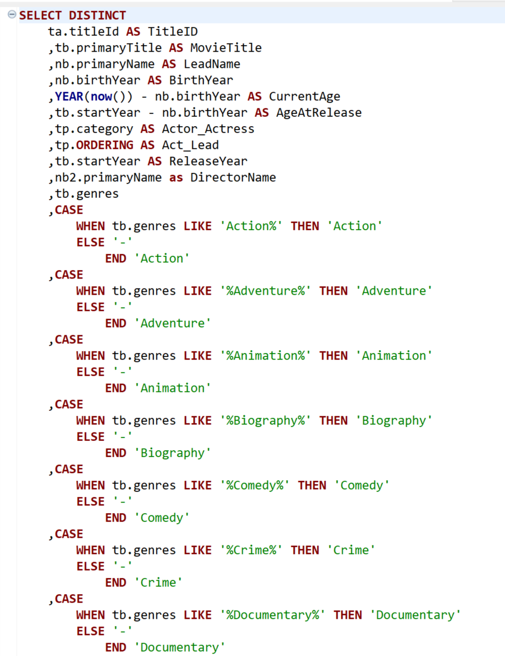
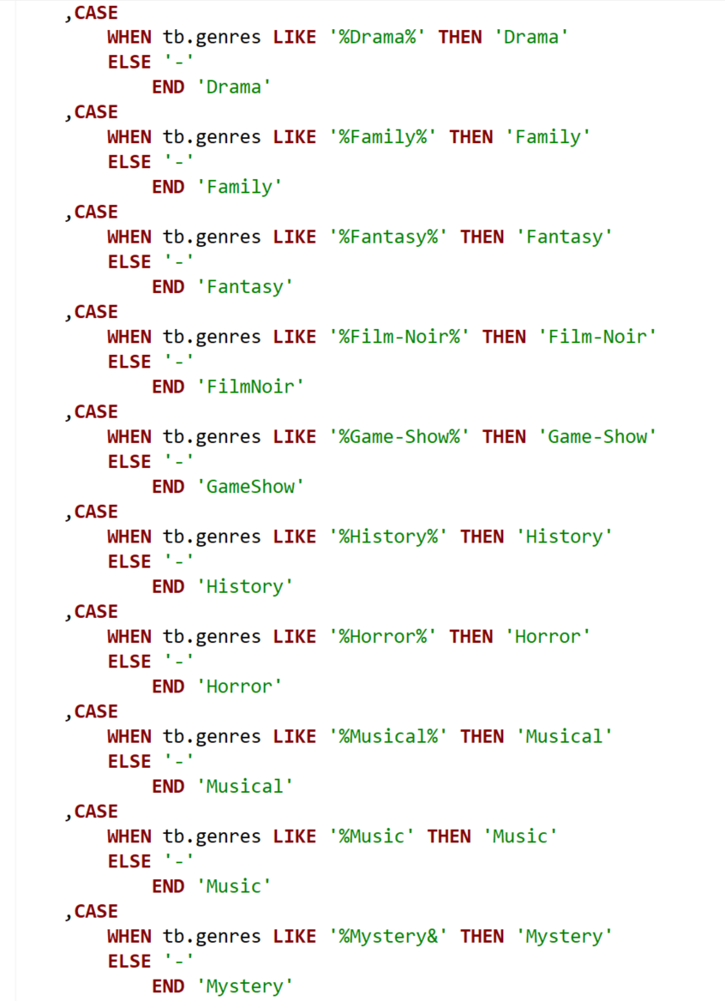
SQL created for the analysis | 1 of 2

Slide 26
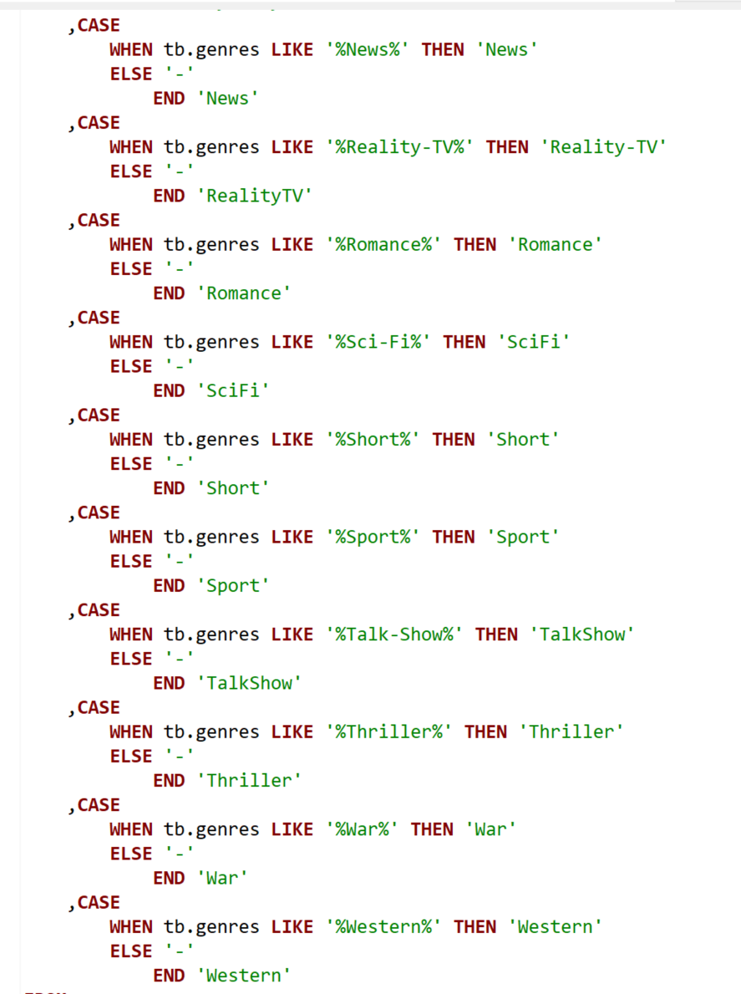
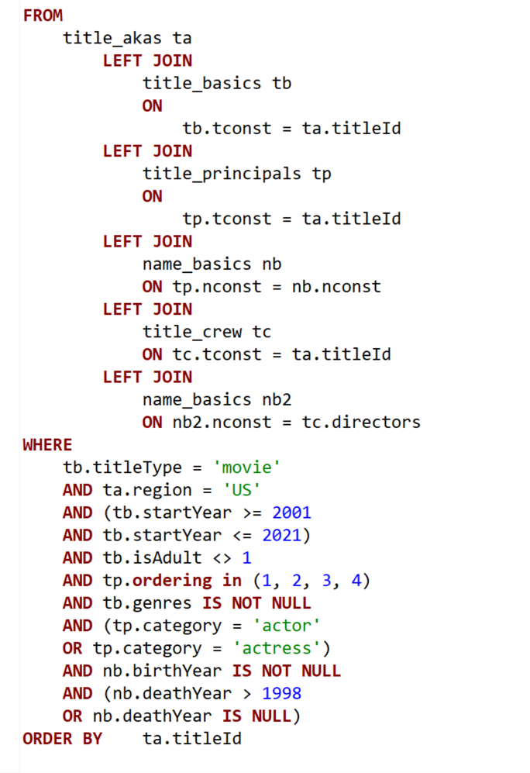
SQL created for the analysis | 2 of 2

Slide 27
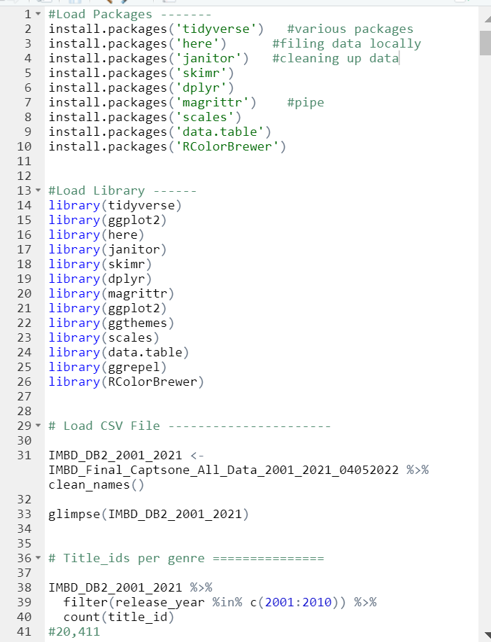
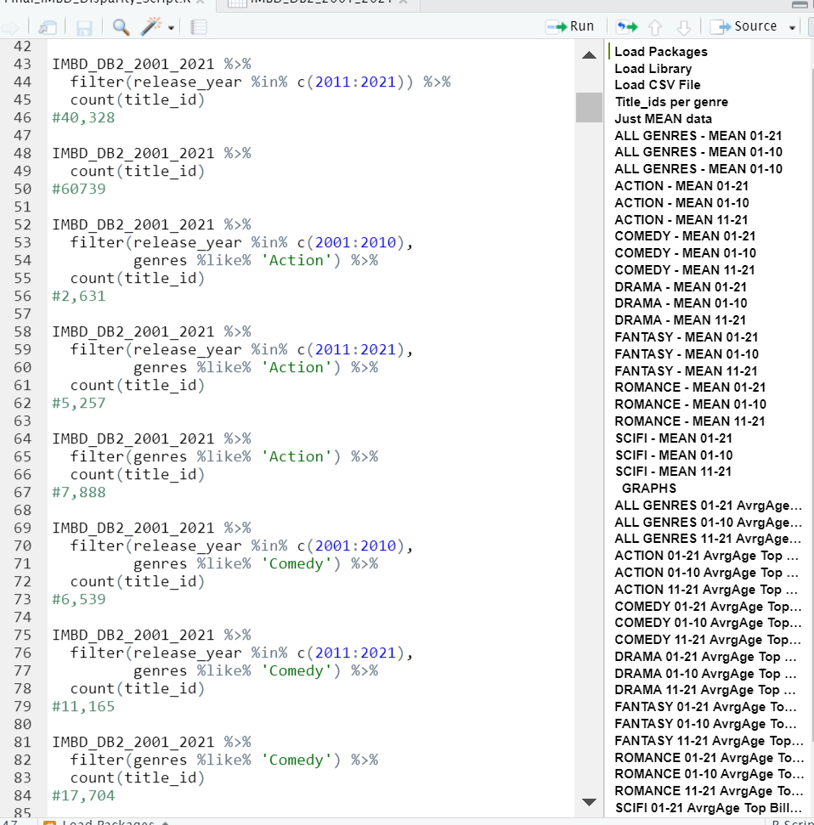
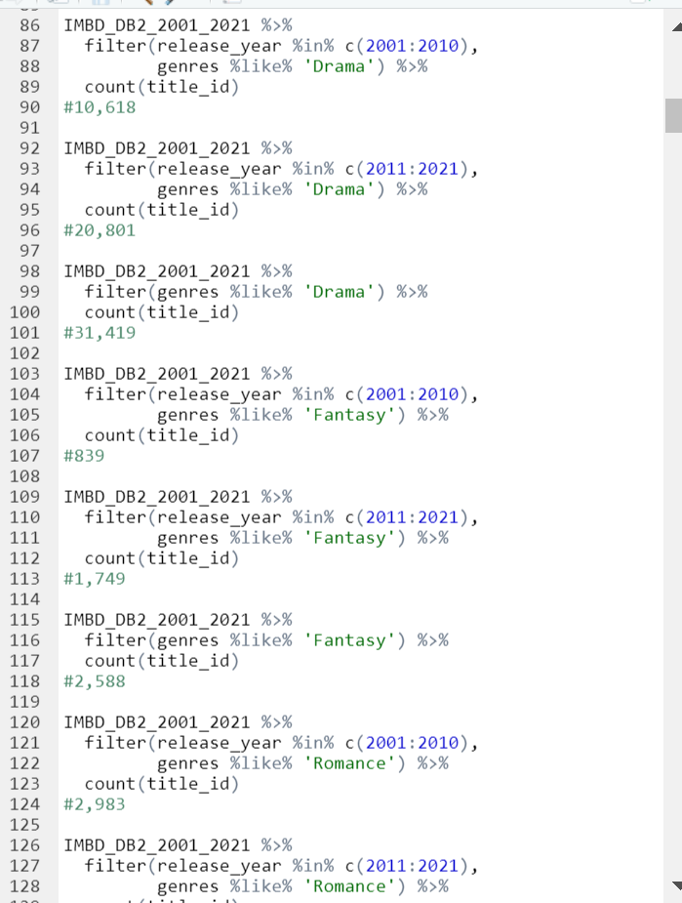
R script created for the analysis | 1 of 10

Slide 28
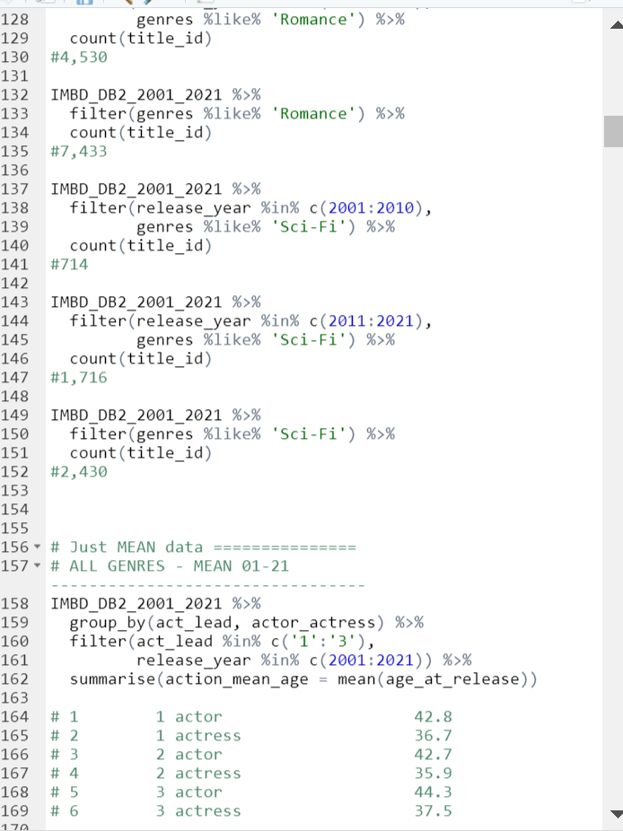
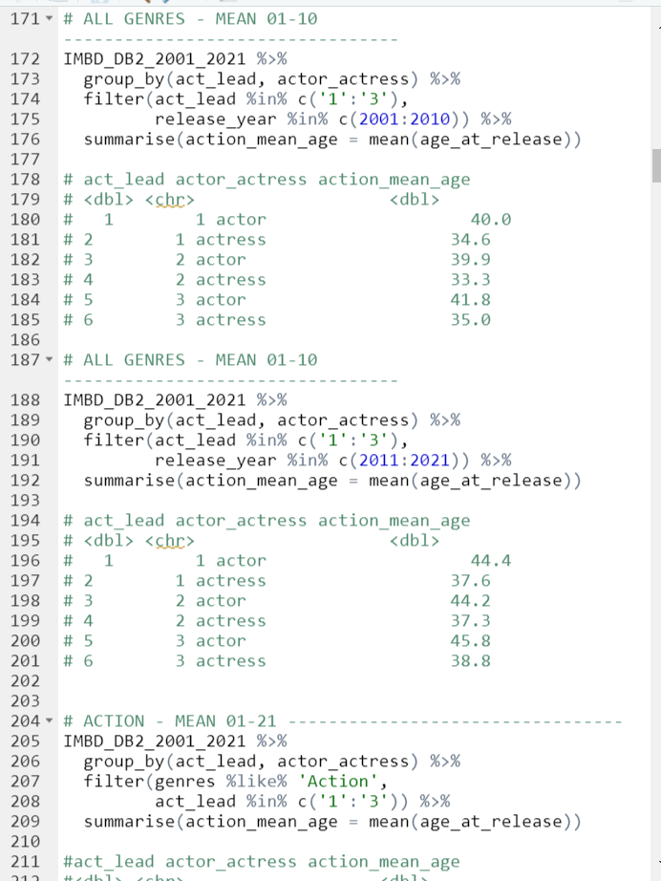
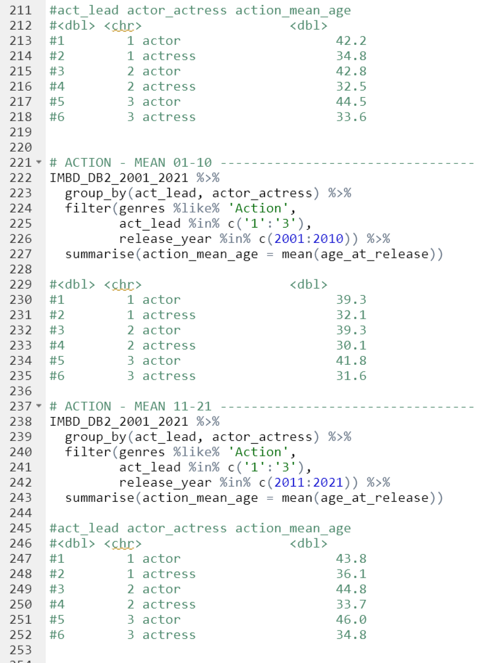
R script created for the analysis | 2 of 10

Slide 29
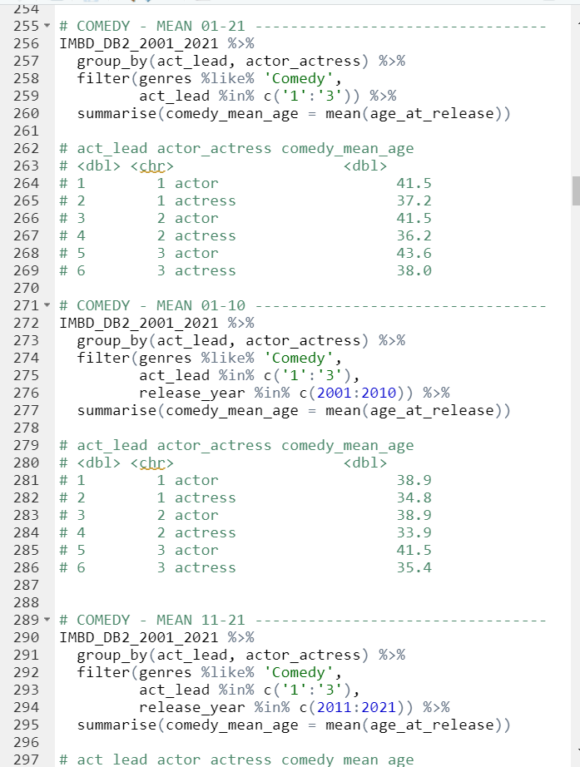
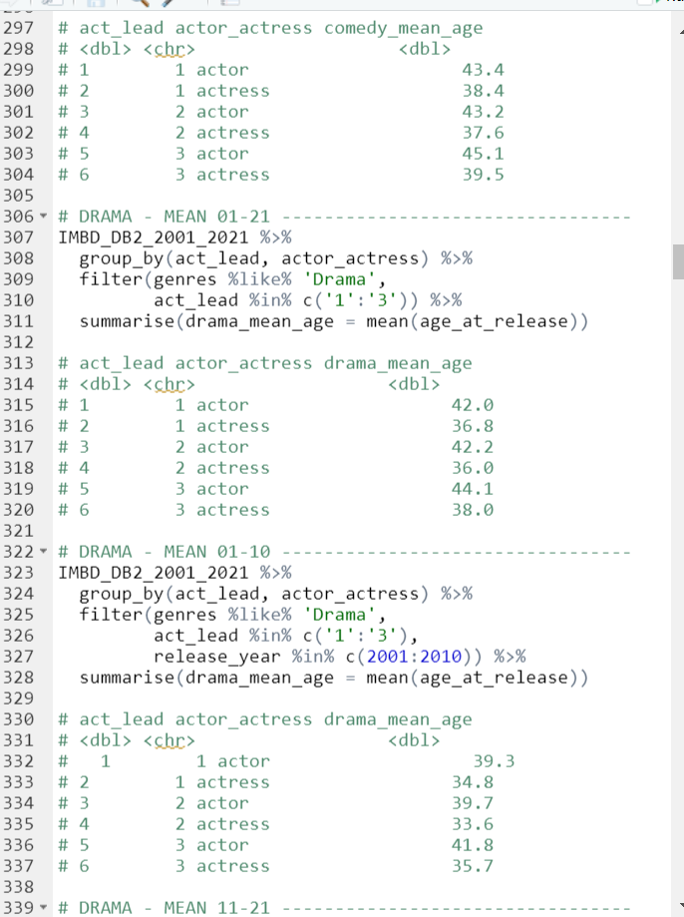
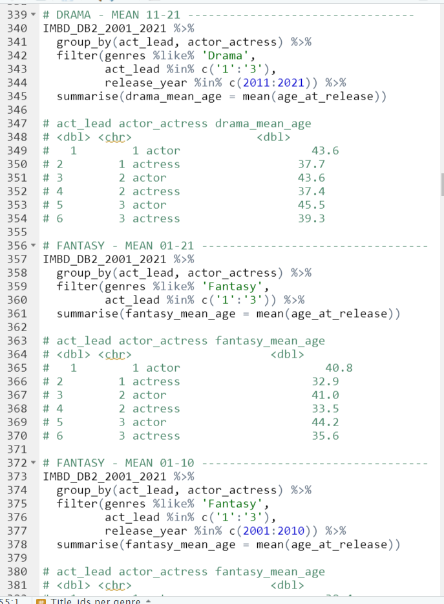
R script created for the analysis | 3 of 10

Slide 30
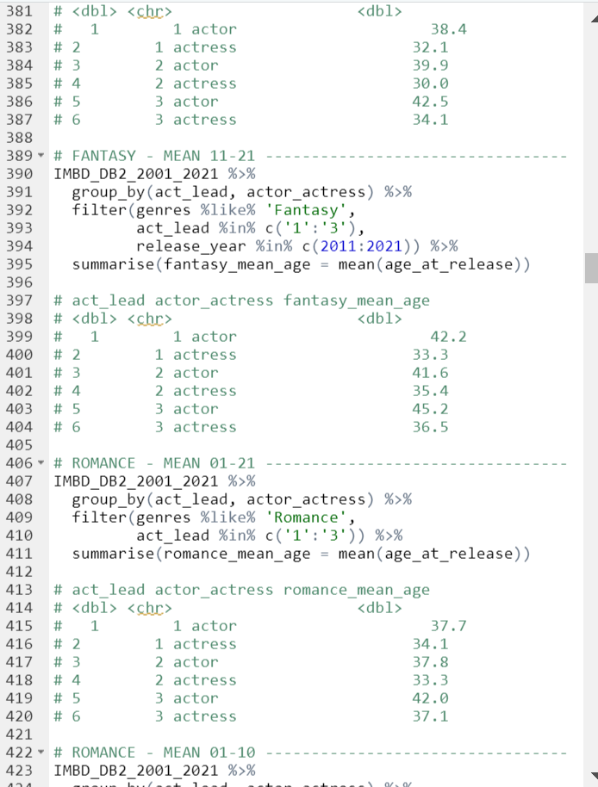
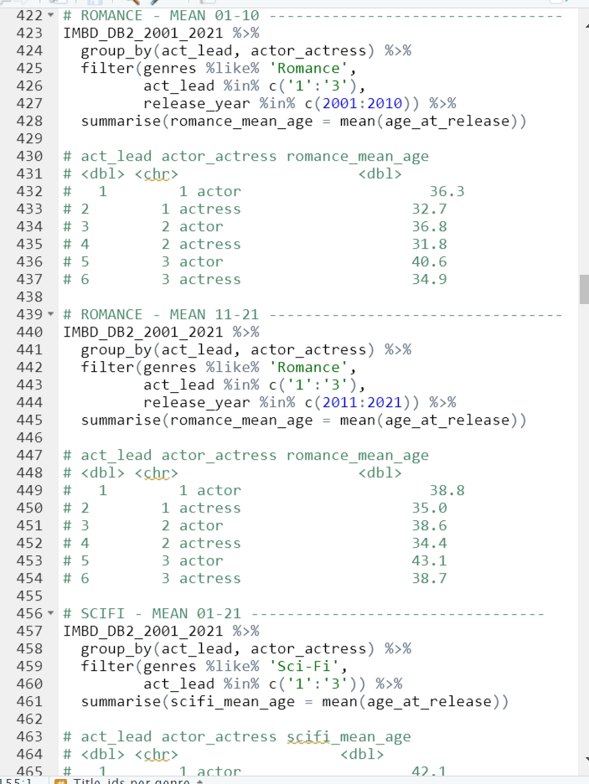
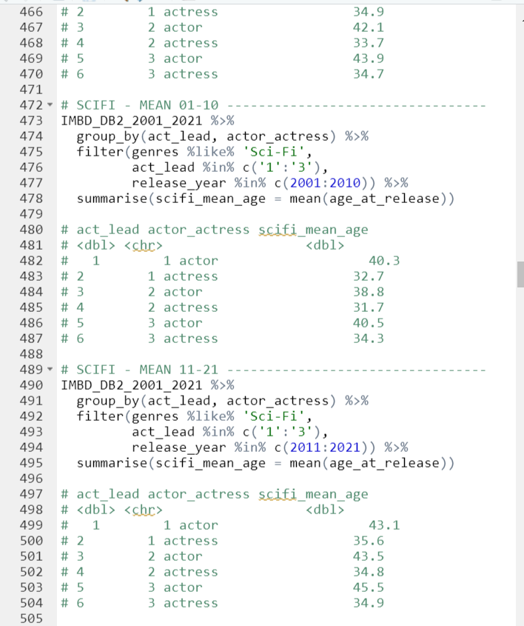
R script created for the analysis | 4 of 10

Slide 31
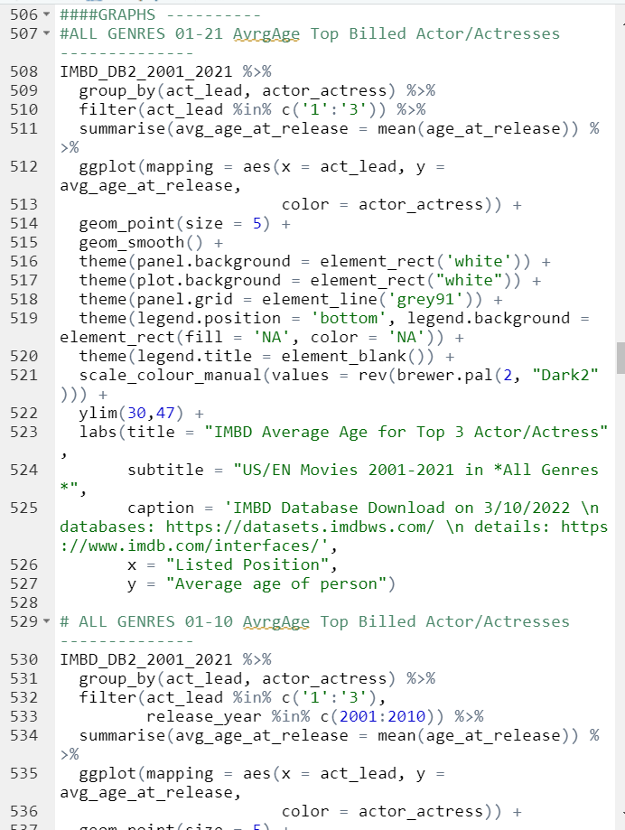
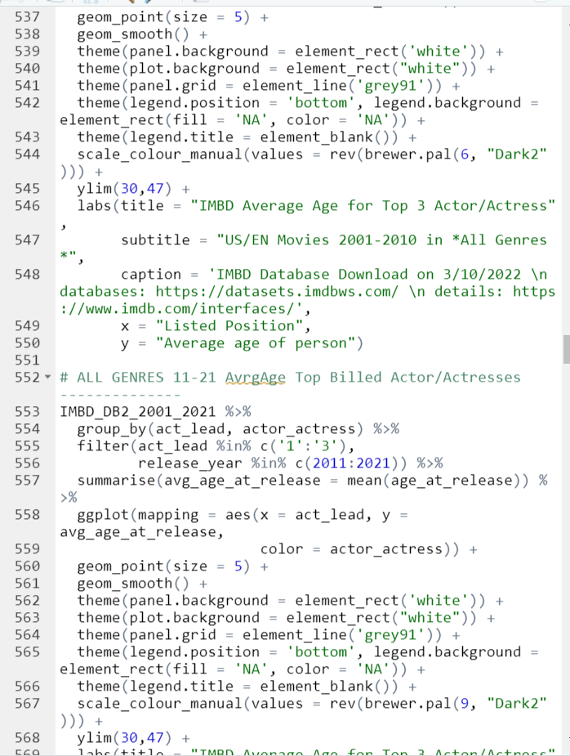
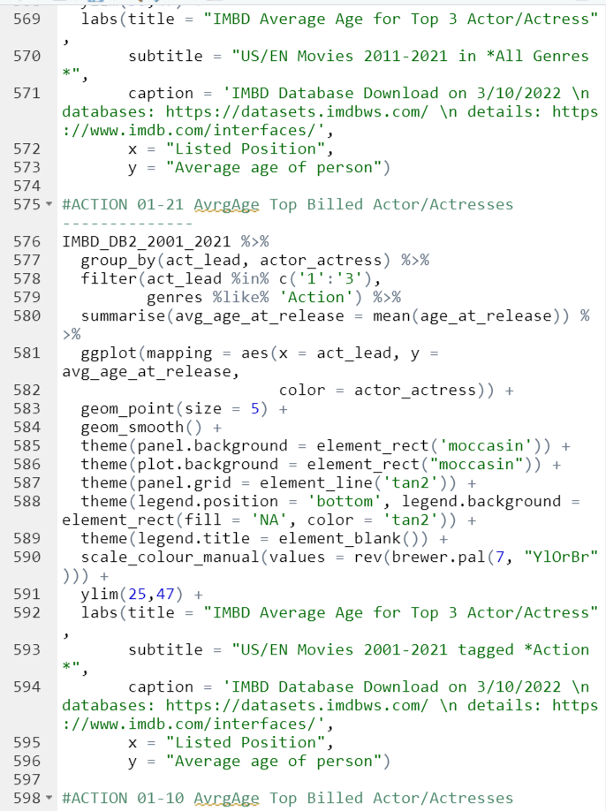
R script created for the analysis | 5 of 10

Slide 32
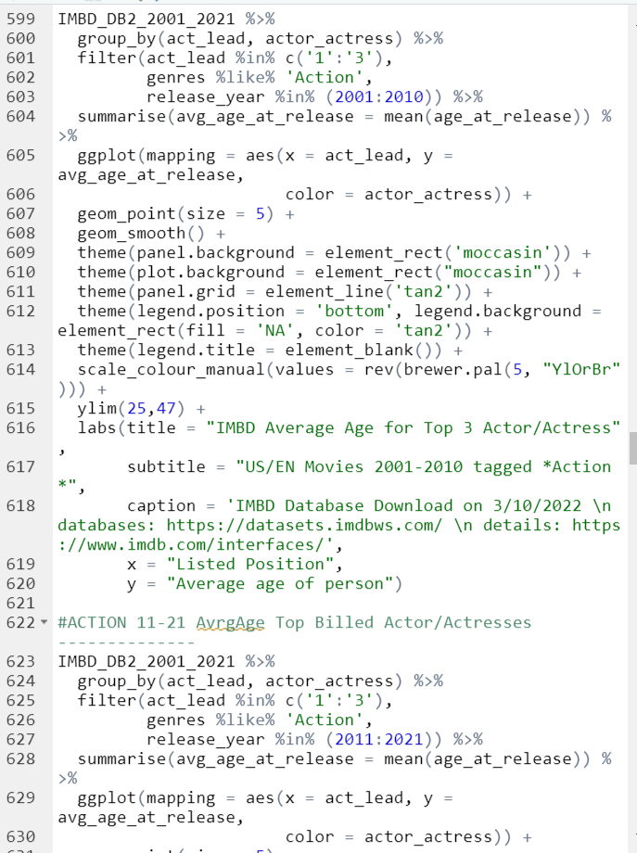
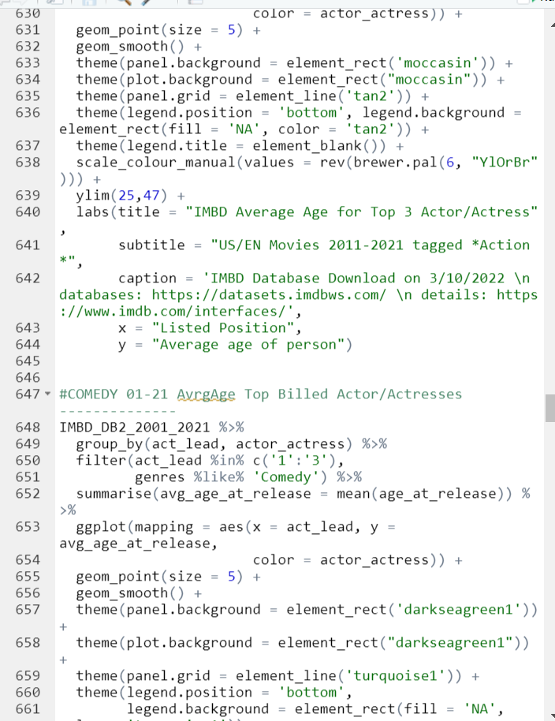
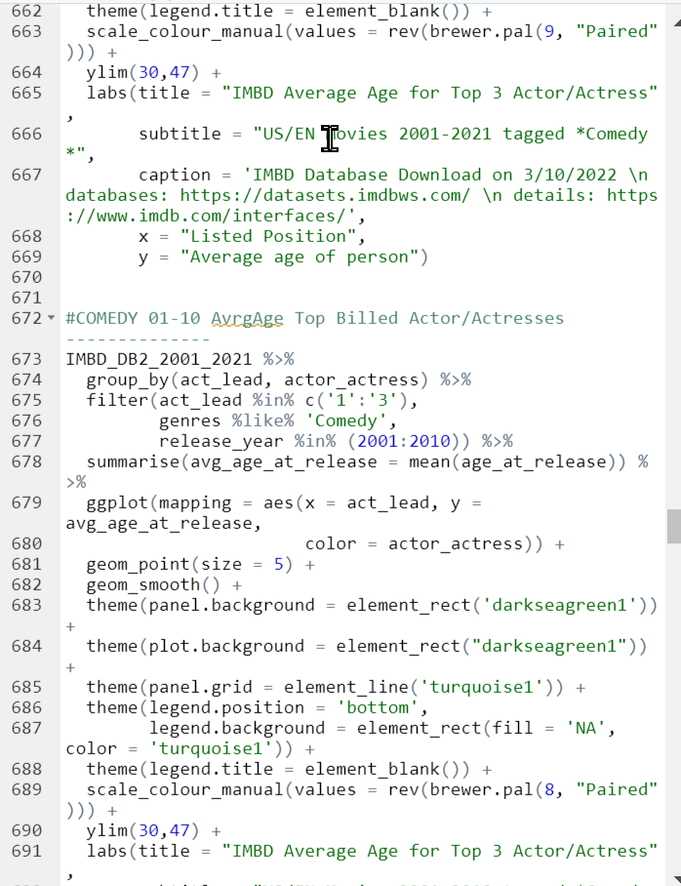
R script created for the analysis | 6 of 10

Slide 33
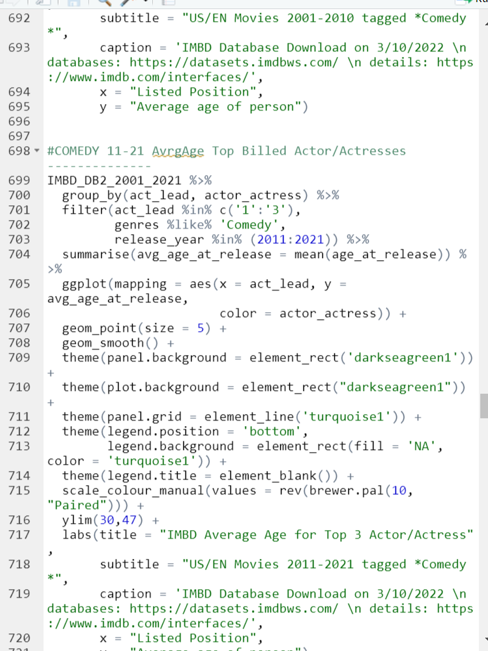
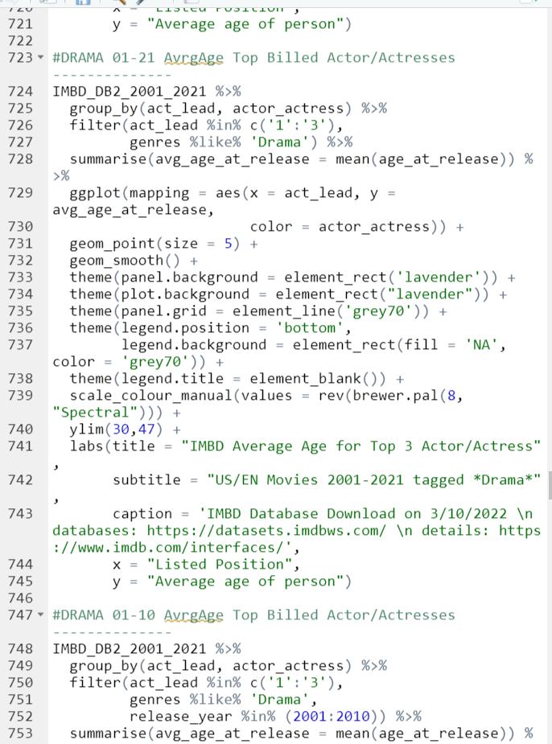
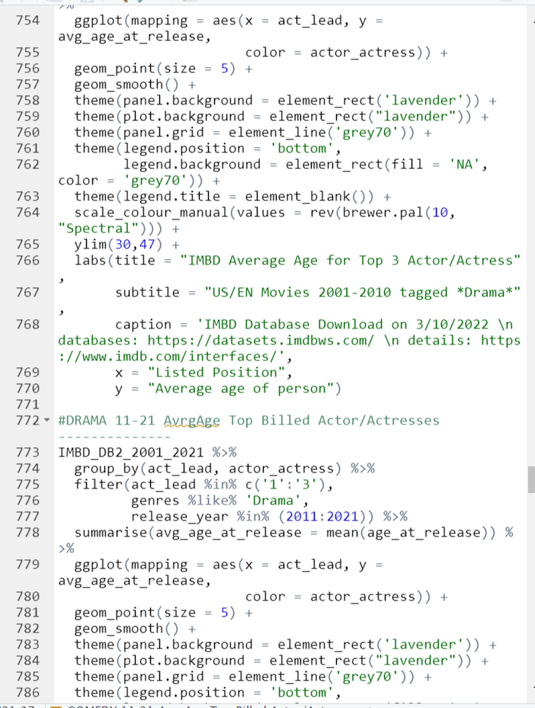
R script created for the analysis | 7 of 10

Slide 34
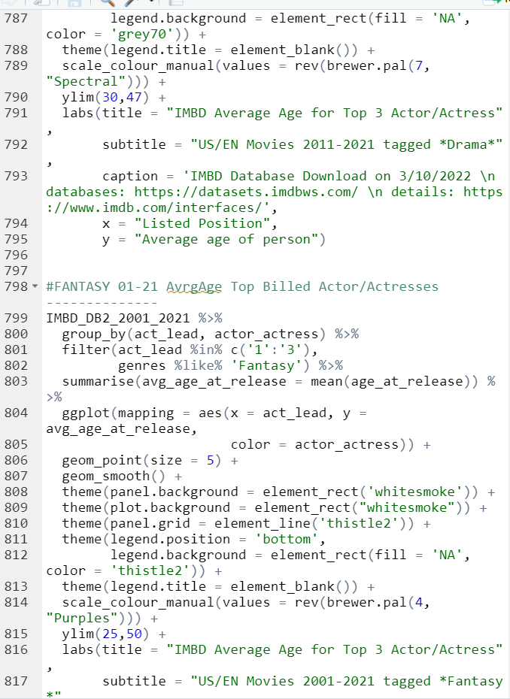
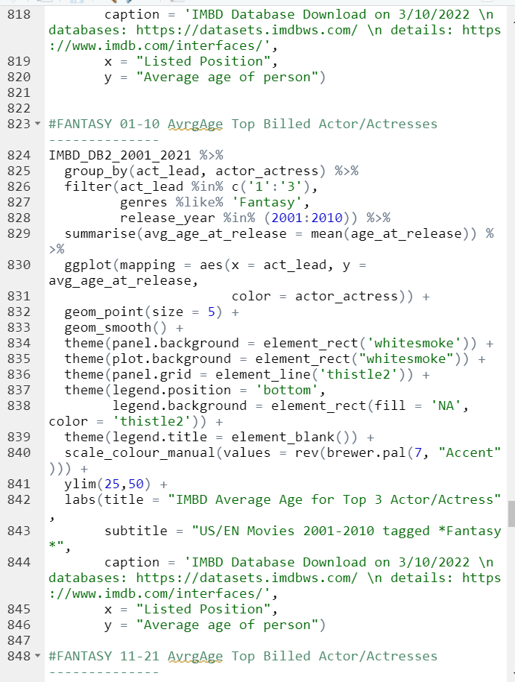
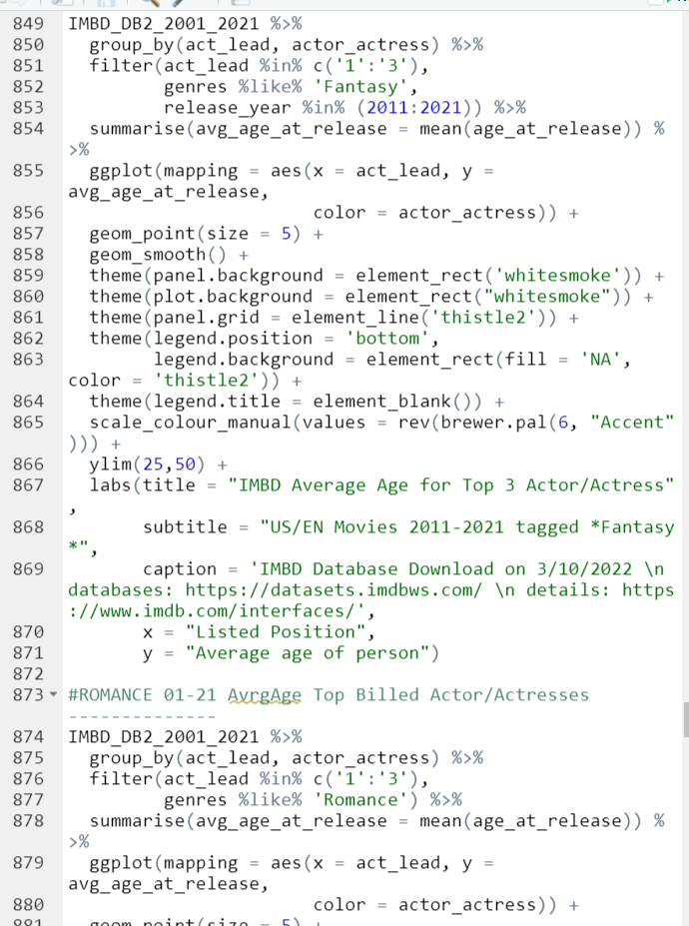
R script created for the analysis | 8 of 10

Slide 35
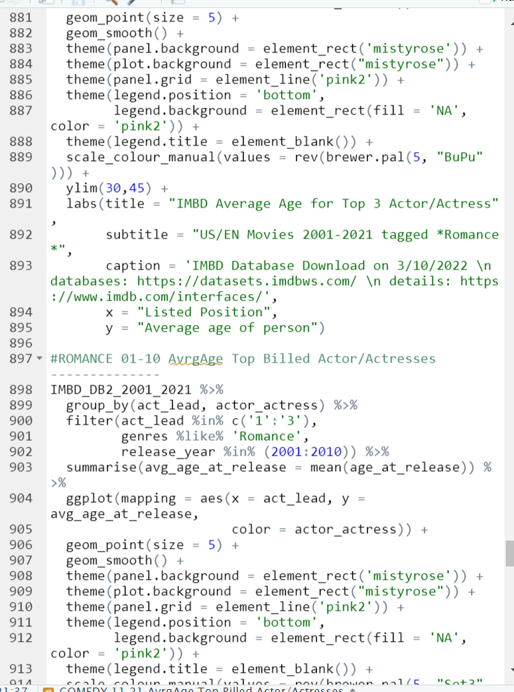


R script created for the analysis | 9 of 10

Slide 36



R script created for the analysis | 10 of 10

Slide 37
How to ask for help
I wanted to close this document out with a personal thank you to Scott McCollough, my partner, and full-time SDET who graciously helped me get through some rough patches when it came to not only learning SQL, but also getting the data into a manageable form that would not crash my computer.
Scott, thank you so very much for using your amazing Python skills to decrease the table file sizes by using my requested filters by table. The shear volume of unneeded data removed before I could use my database was immensely helpful.
The following are some examples of filtered data that Scott removed including, but not limited to, unneeded media types such as episodic events, shorts, video games, and videos as well as person’s who passed prior to 1921 or those without a birth year, which was needed to determine the mean. Additionally, non-US countries and non-English titles were also removed.
Without you, this analysis could not have happened.

